Slide 1

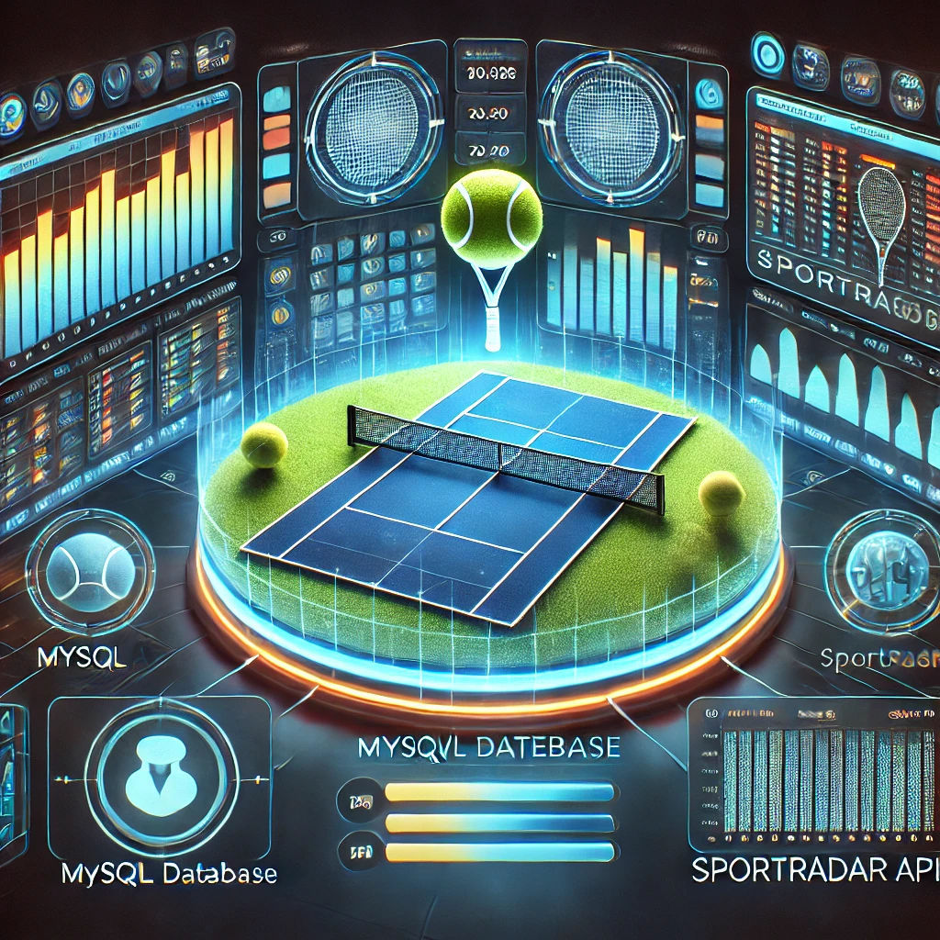
Tennis Data Analytics: Sport Radar API & Streamlit Dashboard
GUVI- DATA SCIENCE
Name : Sham Prasath Kannaiyan
Batch : DS-C-WD-E-B34
Batch Type : WD

Slide 2

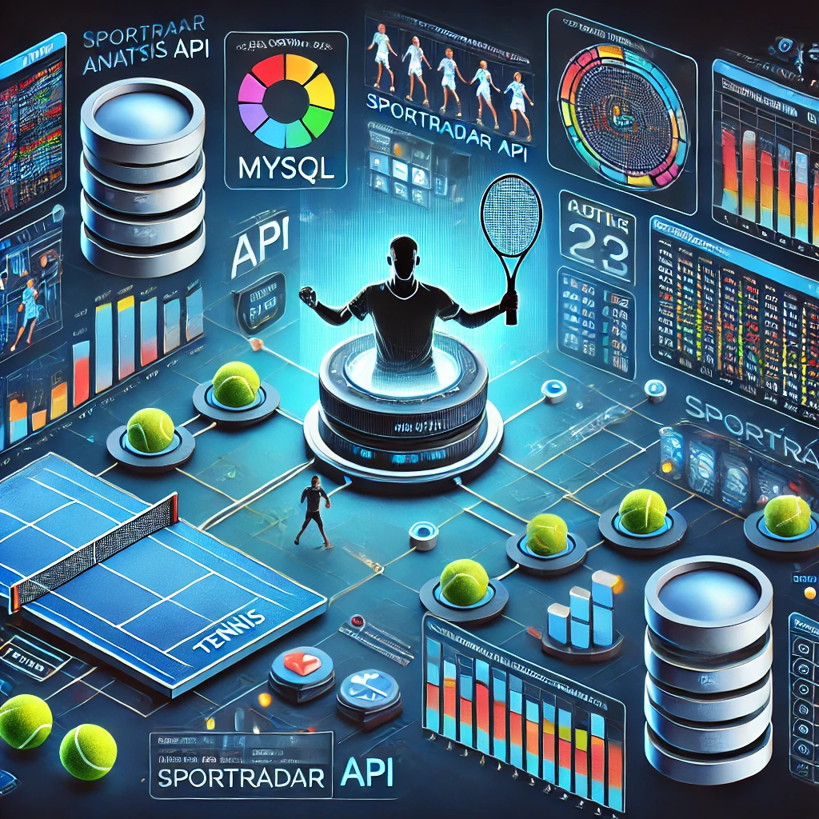
Problem Statement
🔹 Comprehensive Sports Data Solution – Manage, visualize, and analyse sports competition data from the Sport Radar API.
🔹 Automated Data Processing – Parse JSON data, structure it in a relational database, and ensure efficient storage.
🔹 Tournament & Event Insights – Provide hierarchical competition structures, event breakdowns, and key analytics.
🔹 Real-Time Analytics & Trends – Assist analysts, organizations, and enthusiasts in exploring competition trends dynamically.
🔹 Interactive Visualization – Enable intuitive dashboards for deeper insights into tournaments and rankings.
🔹 Enhanced Decision-Making – Deliver detailed, structured data to facilitate better sports analysis and engagement.
230 mm

Slide 3
API Calls
Data Processing
MySQL Storage
Streamlit Dashboard
System Architecture Diagram
Implemented SQL queries
Data Visualization Dashboard
Sport radar data to JSON data
Data insertion and retrieval
230 mm

Slide 4
Data Collection (API Integration)
Competitions Data
Complexes & Venues
Doubles Competitor Rankings
Stores details of various tennis competitions and their classification.
Competition ID, Name, Type, Gender, Parent ID, Category ID (FK).
Manages information about sports complexes and associated venues.
Complex ID, Name, Venue ID, City, Country, Country Code, Time zone.
Tracks player rankings, movement, and performance in doubles competitions
Rank ID, Rank, Movement, Points, Competitions Played, Competitor ID (FK)

Slide 5
Data Processing & Transformation
API Integration
Database Storage
Visualization
Data Parsing
Data Cleaning
Used Python requests to fetch real-time data from Sport Radar API
Challenges
API Rate Limits
Handling Missing Data
Data Normalization
Extracted JSON response and converted it into structured pandas Data Frames
Handled missing values, normalized formats, and ensured consistency
Inserted cleaned data into MySQL tables using MySQL. Connector
Connected data to Streamlit for interactive dashboards.

Slide 6
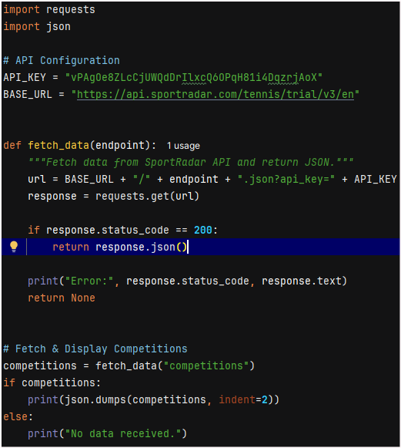
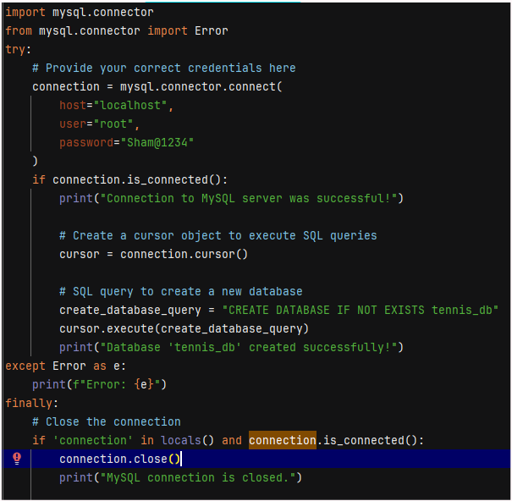
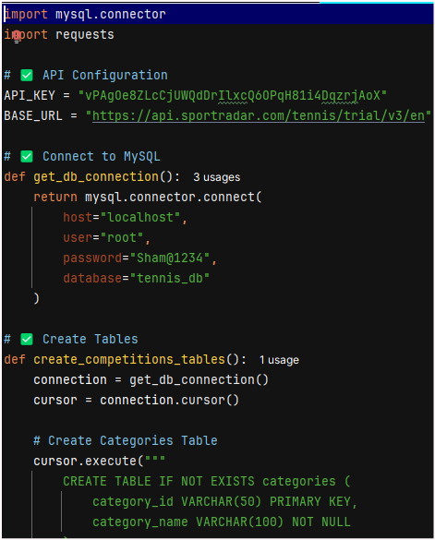
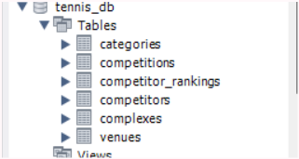
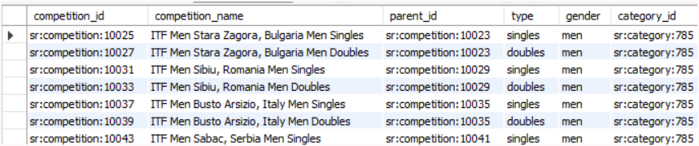
Python code & SQL Data

Slide 7
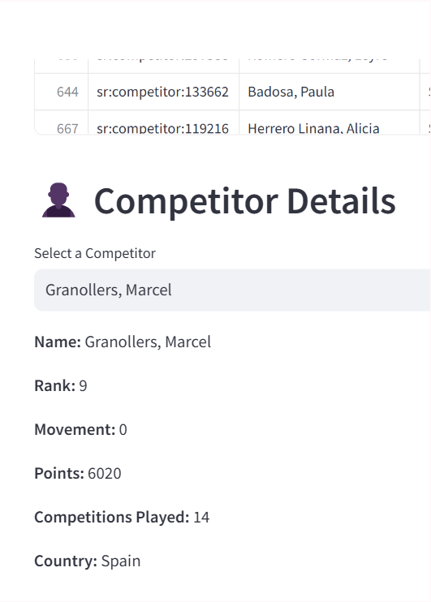
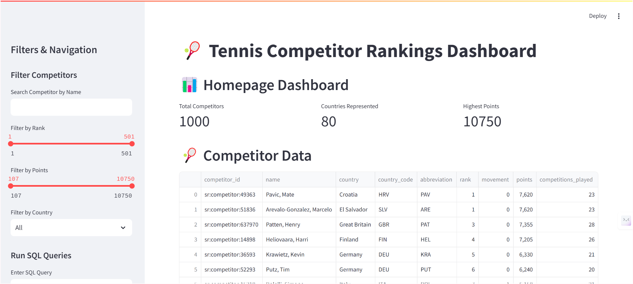
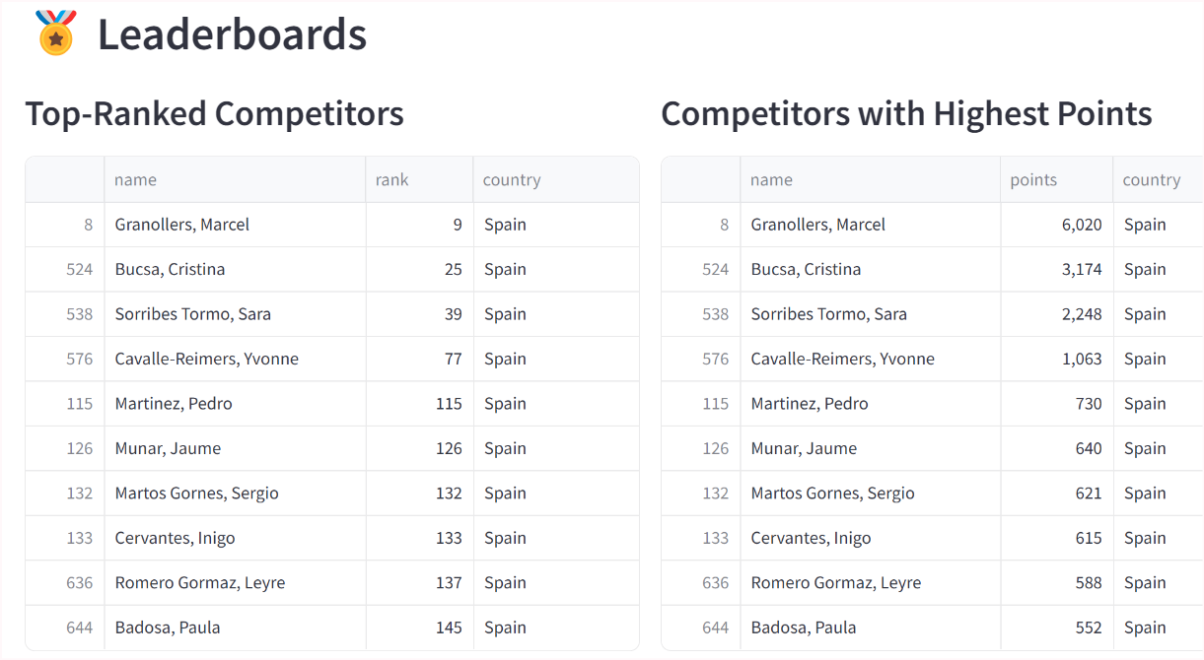
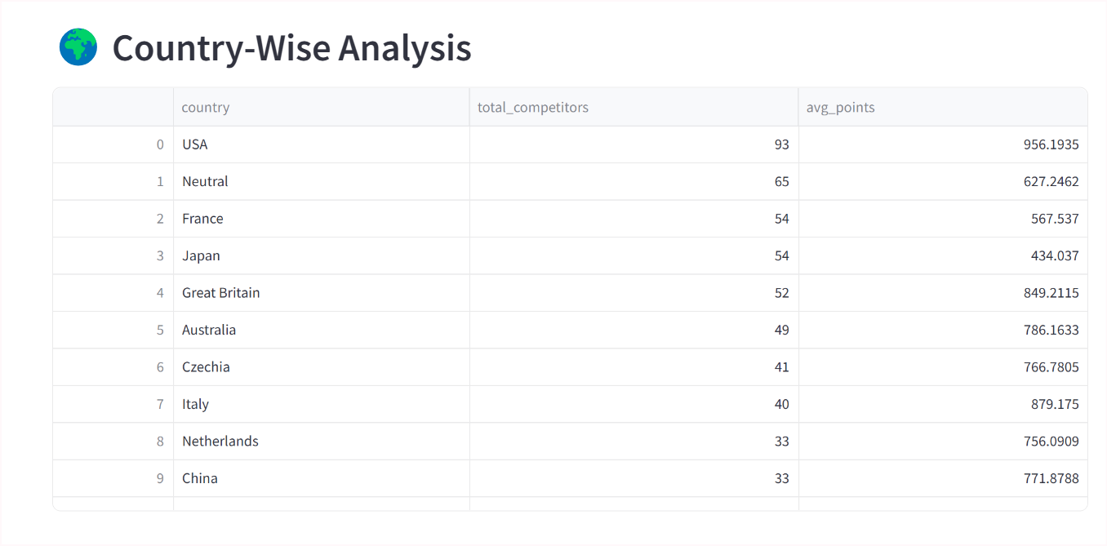
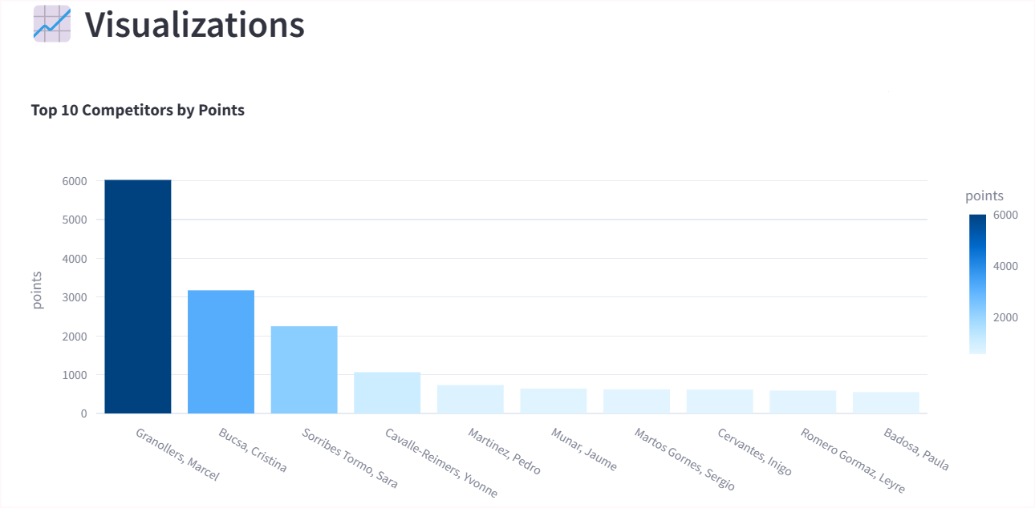
Streamlit Dashboard Features

Slide 8

Future Scope
Advanced Optimization: Ai-Driven Predictive analytics for player performance trends and match outcomes.
UI Enhancements: Real-time data visualization updates and interactive filtering for better user experience
Data Integration: Seamless AI expansion to include historical data and advanced event insights.
Automated Ranking System Generation: Machine learning-based ranking adjustments and competitor performance tracking.
Standards Compliance: Ensuring compatibility with global sports data standards and federations.
Cloud-Based Collaboration: Real-time database aces and multi-user dash board for enchased analytics.

Slide 9

GUVI- DATA SCIENCE
Thank you!
Data is the new game-changer—unlocking insights, elevating strategy, and redefining tennis analytics

